Slide 1
Impact of Human Resource Management on employer job selection

Slide 2
Human Resource Management
Human resource management (HRM) is the strategic and coherent approach towards the administration of an organization's largely valued assets, the people. The Human resource management main role is to sustain employees of an industry is to make sure that the adequate employee's levels by means of the right skills, correctly compensated and encouraged.
All the activities of an organization are done effectively by the Human resource panel. Staffing purpose of an organization is done by Human resource management. It comprises of the activities of human resources planning, recruitment, selection, orientation and training.
Nowadays numerous businesses are ramping towards Human Resources Outsourcing (HRO) since it removes the load of administration as well as changing their focus again to before the individual’s policies. Their main goal is to reduce the expenses and at the same time, organizations are also looking before the Human Resource Management to offer first-rate service to their employees.

Slide 3
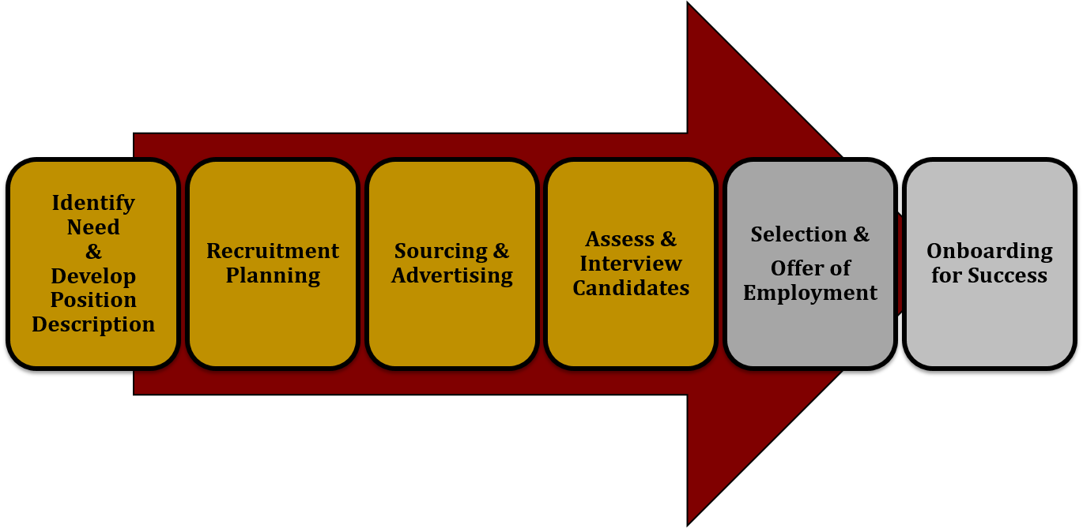
Job Selection
Job Selection means selecting the right person for the right kind of a job according to the company demand and person’s ability. It is the process of opting within the scores of job seekers with necessary qualification as well as competence to fill the position in the organization. Few of the selection process could be applied within the organization as a part of promoting and transferring. In selection criteria the candidates are cautiously picked up as per their ability.
Staffs play an important function in the achievement of any company. When an organization wants to achieve their goals and target and the organization wants to be successful and wants to win the race against the competitors, they need to hire the best of the individuals who can work effectively and efficiently. Thus a wrong person selected can cause a reputation loss or failure in meeting the goals. A cautious approach needs to be taken while selecting the candidate to be more successful in the market.

Slide 4
Job Selection process by HRM
Job selection process means the combination of measure taken, or procedure used as per the basis of some employment judgment. In selection process short listing is done as per the ability and performance of the candidate.
Below are the various stages in selection process,
Application: Applicants are welcomed by e-mail or telephone by the Human Resources team.
Selection Methods: Selection system will be carried out to decided by the HRM team for the selected candidates by the below stages.
Panel interview
Presentation
Selection tests

Slide 5

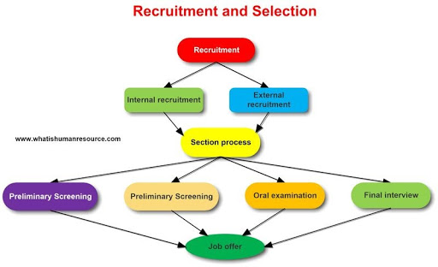
During selection all the academic and experience of the candidate is verified by the Human Resource team to ensure that they meet the compliance and integrity of the organization as well as to suit for the post of the job.
Usually in External Selection phase this kind of procedure is followed. While during Internal selection, all the employees who are shortlisted and interviewed for the position if they meet up the important criteria for the job. During the internal selection employees if the employ is selected, they are promoted or at least get a raise in their salary.

Slide 6
Input by HR implemented plans
HR must plan their strategies for the recruitment and selection in such a way that they provide the success of the organization. They need to find out the areas through which capable candidates are selected. HR should be able to identify which candidate can perform the job in a best possible way. If in case their plans are not work out correctly, it will affect the whole performance of the organization. Thus it will increase the expenses of the labor cost which is not a good sign for organization.
HR team needs to put an additional crack for the development and implementation for the recruiting and selecting process. They need to be thoroughly approached for assessing the candidate to fill up the job and candidate should have the ability and potential. They should be fair while recruiting and selecting as they have responsibility to make sure that no bad feeling occurs in the mind of the candidate as sometimes, they feel they were discriminated , which can lower the reputation of the organization.

Slide 7
Conclusion
During current circumstances, organizations are no more competing with their competitors, price, packaging and product. Their main competition is to look for the most excellent talent existing in the market. Nowadays companies with the best talent available in the market prevails has the load of talented people working that’s why during recession their layoff rate was so low in that scenario also as they knew with the talent in their employees, they have still they can excel in the market. We can say recruitment and selection process plays an important role for the hiring of the employees.
Selection process should be introduced in a way that an organization achieved the goals like group discussion, online interview. If we see the history most of the companies have decided on budding the selection process for the job by HRM.

Slide 8




Thank you
-Nipun Narang

